Slide 1

PM SCHOOL LIVE CASE CHALLENGE
Swiggy minis

Slide 2
The Problem Statement
You’ve joined Swiggy as Head of Product and Innovation, heading Minis.
Swiggy Minis is a self-service platform that allows businesses to set up their online store and reach out and sell to customers - both local and pan India. It offers a variety of features for small businesses like, easy digital store setup, access to customer data, zero commissions, chat tools, integrated logistic partners, etc. Swiggy Minis was launched in 2020, and it has since grown to become one of the most popular e-commerce platforms for small and medium-sized businesses in India. In 2022-23, Swiggy Minis processed over 100 million orders, and it has a network of over 500,000 merchants.
You have been given the responsibility to drive traction and improve adoption and engagement metrics for Swiggy Minis, focusing on merchant onboarding and average customer order value. Try to ideate and suggest new features, revamp existing ones, which will eventually drive the growth of these metrics. Also suggest new revenue models for Minis, if possible.

Slide 3
About Swiggy Minis
Swiggy Minis was launched in 2020, and it has since grown to become one of the most popular e-commerce platforms for small and medium-sized businesses in India. In 2022-23, Swiggy Minis processed over 100 million orders, and it has a network of over 500,000 merchants.
Swiggy Minis is a self-service platform that allows businesses to set up their online store and reach out and sell to customers - both local and pan India.
The platform is designed to make it easy for businesses to start selling online, even if they have no prior experience with e- commerce. Merchants can create their own storefronts, upload product catalogs, and manage their orders all from a single dashboard.
USP of Swiggy Minis :-
Allows sellers to sell their products across India without any commission charged on their sales .
Problems that the platform solves
Operational hassles: Swiggy Minis simplifies the online selling process by allowing sellers to set up their store in 3 simple steps, manage their catalog, orders, payments, and logistics from one dashboard, and access customer data and insights.
Limited reach: Swiggy Minis enables sellers to reach a wider audience by leveraging Swiggy’s existing user base and delivery network. Sellers can sell anything across India, not just food, and choose their preferred delivery partner or opt for self-delivery.
High commissions: Swiggy Minis does not charge any commission from the sellers, unlike other marketplaces that take a cut from every sale. This means that sellers can keep all their profits and have more control over their pricing and margins

Slide 4
Market Analysis
Large seller 5%
Though the COVID-19 period demanded the retail market to shift to
Medium seller
the online mode, experts say that several small businesses in India
recognised the potential of online sales 5 years ago. Looking back at its growth since the past decade, government policies such as ‘Digital India’ and ‘Skill India’ are accelerating the process of new-age
technology to go virtual.
20%
Small seller 75%
The e-commerce market in India was valued at INR 6,210.96 Bn in
2021. It is anticipated to reach a value of INR 26,459.18 Bn by the end of 2027 .
Small seller- Less than 2cr income Medium seller- Between 2cr and 7cr Large seller- More than 7cr income
According to a recent report published by the RedSeer, the CAGR for online retail as a whole is predicted to be 25% through Financial Year 2027, wherein MSMEs would outgrow it significantly at a CAGR of
60–70%, contributing $50 billion to the Indian online retail sector.
Medium seller and small seller respective shares of the gross merchandise value (GMV) of Indian e- commerce are 10–18% and 5–10%.
According to industry experts, with 1.5–2.5 million online retailers, the percentage of MSMEs selling goods online is likely to triple to 5-6%
by 2027, reaching 5.5–6 million online MSME retailers.
Source

Slide 5





User Persona
Babita
Age: 35 Homemaker Mumbai, India
Rahul
Age: 28 Buisnessman Delhi, India
Riya Age: 20 Student
Pune, India
Goals
To sell her hand made decor items to a wider audience
To generate extra income for her family
Goals
To expand his customer base beyond his local area .
To increase sales and profits
Goals
To start his own fashion brand business .
To gain experience in e-commerce
Pain Points
She doesn't have a lot of time to market her business
She is not very tech-savvy
Pain Points
Doesn’t have any prior audience where he can market his products .
Due to unavailability of multilingual option he faces problems in using the app .
Pain Points
She doesn't have a lot of business experience
She doesn’t know how to rightly market her product and reach to potential customers .

Slide 6



The Competition
Shopify
Dukaan
Woocommerce
No of downloads
10M+
5M+
500K+
Rating
4.5
4.1
4.8
Shopify offers a range of SEO tools to help businesses improve their online visibility and drive more organic traffic to their store.
Easy to use software, and creates the shop within
minutes
It provides thousands of customizations You can add new features or plugins and customize them accordingly.
Pros
Transaction fees for using any 3rd party payments option other than shopify payments .
It is a open source software and has no support team available .
Cons
Very bad customer support services .

Slide 7


Defining Problem Space
In the course of our primary and secondary research, we had conversations with multiple sellers and identified the following as the main issues:
5 1
At present, the platform lacks the option of custom themes.
Given that a unique UI design can be the differentiating factor for online stores, it's essential to offer a variety of themes that stand out.
Customers are experiencing difficulty in locating the Swiggy Minis option within the Swiggy app. Presently, the app only displays the minis feature once the customer has clicked on a minis store link. The customers' unfamiliarity with
purchasing products from these stores is hindering the adoption rate of this feature. This issue needs to be addressed urgently to improve the overall customer
experience.
4
Why Some Sellers Do Not Utilize In-built Delivery Options?
High delivery charges, lack of trust in delivery partners, or the seller's inability to see the advantages of using this feature.
2
Difficulty Incorporating Product Variants Leads to Negative Seller Impressions
A vast majority of products come in different colors and sizes, yet sellers are unable to add various options to their products. This issue has created a poor impression among many sellers.
3
Swiggy Minis' current model lacks a viable approach for expanding its network.
Presently, the Minis store functions through a link that enables customers to purchase products.
However, if sellers already possess a substantial network to share their store link with, then why would the seller adopt Swiggy Minis in the first
place.
Link to the primary & secondary reasearch

Slide 8
Solution And Prioritization
Reach
(10)
8
10
8
10
Impact
(5)
3
5
4
4
Confidence
(100)
80
90
80
90
Effort
(10)
7
8
8
9
Pain Points
Language barrier with some of the users .
Less visibility of products .
No option for selection of different variants of a product (like size,color) .
Lack of SEO and marketing options in the app for store owners .
Solution
Introduction of multilingual feature to the app
Subscription Model
Add option to select different sizes, colour , and other variants .
Providing the same with subscription based model .
Priority
4
1
3
2

Slide 9


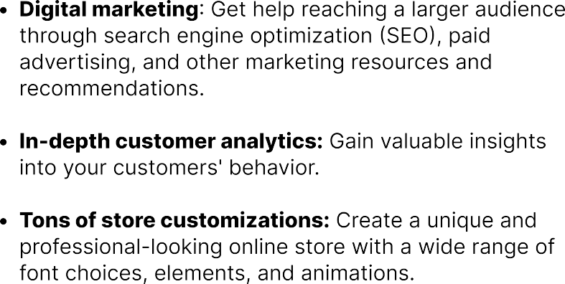


Solution 1: Subscription Model
minis⁺
We’ll be launching a paid service including the following features
Digital marketing
Search engine optimization (SEO) services to help improve the visibility of their online stores.
Paid advertising services to help them reach a wider audience through platforms such as Google Ads and Facebook Ads
Marketing resources and recommendations to help them create and implement effective marketing campaigns.
This feature will be achieved through partnering with third-party marketing websites that specialize in providing these services to small businesses.
Order analytics
This feature will provide subscribers with more detailed insights into their order data. This will include:
Most popular products and categories, average order value and many more
Store customization
This feature will provide subscribers with more options to customize the appearance of their online stores.
A wider range of font choices
More elements and animations to add to their store pages.

Slide 10
Solution 2: Multilingual Support
Implement a language selection option within the Swiggy Minis app that allows users to choose their preferred language. Offer a diverse range of languages based on the demographics of the user base, ensuring inclusivity and accessibility for all. Provide the option to input the product descriptions in multiple languages.
Why is it important?
Ensuring language diversity in the app makes it accessible to a wider range of users. Not everyone is proficient in English or the regional language of a specific area. By offering multiple language options, the app becomes more inclusive, allowing users from various linguistic backgrounds to comfortably use it.
Language is a key component of the user experience. Providing content, navigation, and product descriptions in a user's preferred language enhances their overall experience with the app
Solution 3: Variants Selection
Provide a range of customization options for users to specify various product attributes, including size, color, flavor, or any other pertinent product differentiators.
Ensure that the interface is intuitive and flexible enough to accommodate different types of products and their specific variants. Allow users to upload high-quality images or visual representations of different product variants. Enable them to showcase various color options or size differentiations through clear and appealing visuals

Slide 11
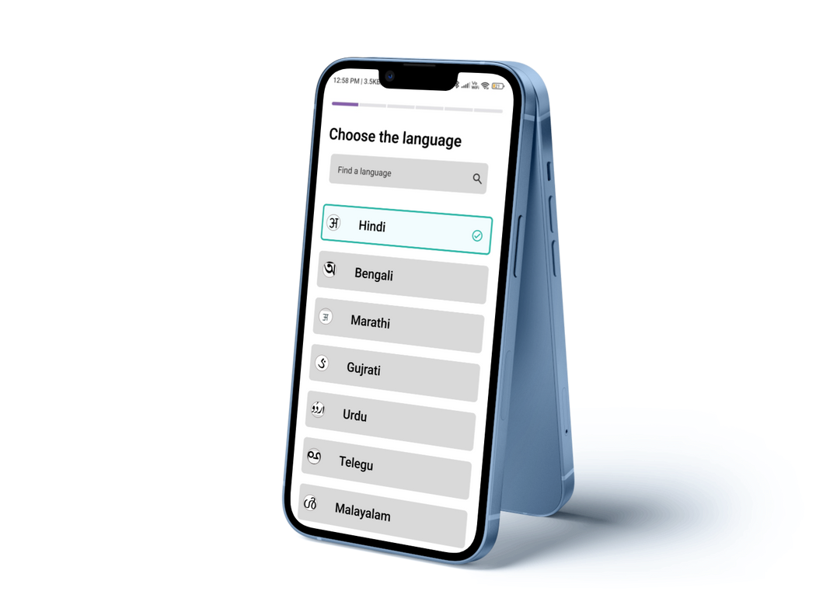
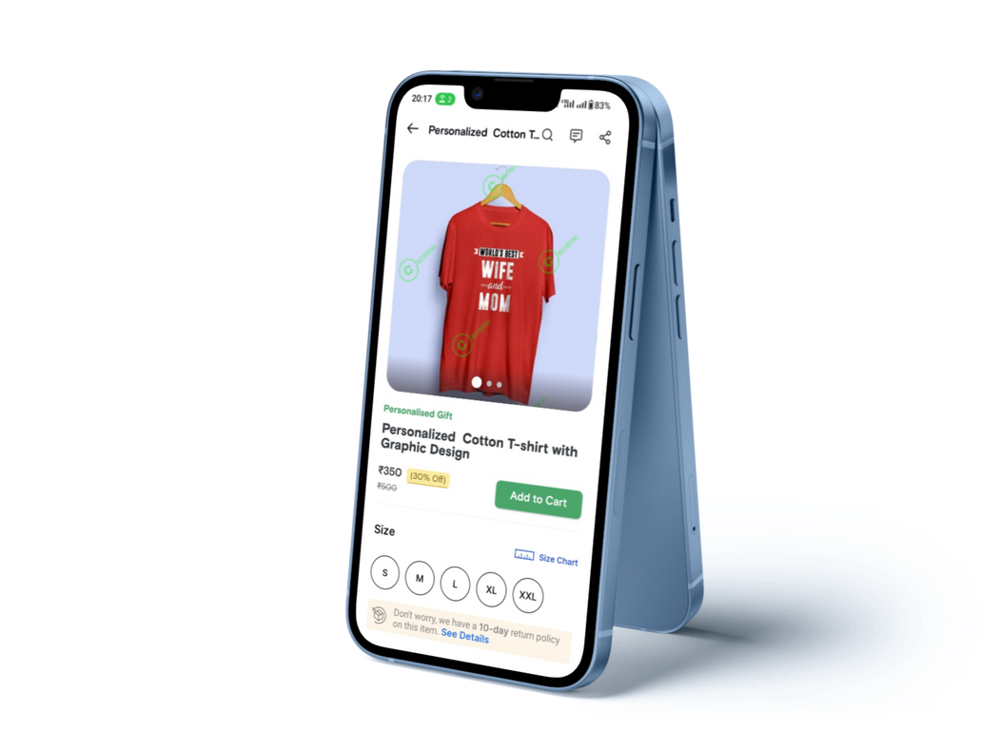
UI SCREEN: MULTILINGUAL SUPPORT
UI SCREEN: VARIANTS SELECTION
Upon initiating the app and progressing through the login process, each user will be presented with the opportunity to choose their preferred language for operating the app. This language selection feature ensures that users can comfortably navigate and interact with the app in a language that is most convenient and familiar to them, right from the very beginning of their app experience.
Permitting sellers to add customized variants of their products, like size, color, or quantity, can benefit both sellers and buyers. This
feature allows sellers to cater to a wider range of customers, while also increasing their sales. Buyers can enjoy a personalized shopping experience by finding products that meet their specific preferences.
Overall, the inclusion of customized variants can improve the shopping experience for both parties.

Slide 12




Go To Market Statergy
Architecture Plan
We need to write a detailed PRD for all the phases and discuss it with different teams .
Work on wireframes effictively with UI/UX team and develop an MVP
Plan for scalability and adaptability. As your customer base
grows, you may need to expand features, integrate with other systems, or support multiple industries.
Develop
Design the backend of the system and build the feature codes as per the product roadmap
Launch & Marketing
Do the required iteration needed based on the user feedback and launch the final product .
Publicise within the target market and collect the uasge statistics .
Feedback & iterate
Test NPS scores to validate user satisfaction . Conduct user surveys , collect feedback, analyze A/B tests and make the necessary changes as per the feedback.

Slide 13
Analyzing Success
USER ADOPTION
Feature no.
Pitfall
Mitigation
Percentage of users who actively select their preferred language Track how many users utilize the customization and image upload
feature. A high usage rate indicates its popularity.
Track how many users utilize the image upload feature to showcase product variants.
Track the percentage of free users who upgrade to the paid service. Measure how many users continue to renew their subscriptions after the initial sign-up.
Dependence on third- party services can lead to issues like service interruptions, changes in pricing, or differences in quality
Carefully vet third- party partners based on their reputation, reliability, and customer reviews.
1.
USER ENGAGEMENT
Measure the percentage of users who click on digital marketing campaigns created using your service.
Measure the increase in organic traffic to users' online stores as a result of SEO improvements.
Track how many users take advantage of the image uploading feature to showcase product variants.
Supporting multiple languages and multilingual product descriptions can increase maintenance complexity
Consider using localization and internationalization frameworks
2.
Include error messages that guide users on how to resolve common technical issues.
Users may encounter technical issues while uploading images, leading to frustration.
3.

Slide 14


THANK YOU
Soumyajit Mondal
Kartik Kumar
Institute - IIT ISM DHANBAD
Institute - IIT ISM DHANBAD

